Slide 1
Autonomous Car
(better name pending)
Group D Members:
Christian Alcalde,
Abdullah Wardak,
Eric Fong
Notes:
Subsystem requirements & specs ..... interface write-ups
• Component selection:
• Approximate bill of materials (BOM) ... what chips & how many to purchase
• Manufacturer’s datasheets (PDF collection ... need not print all of them!)
• Show that you understand how to operate and control each subsystem
• Software overview
• List of tools needed (e.g. compiler, loader, basic I/O system, simulator, etc)
• Document your intended software structure, showing major sections & their
inter-relations
• Discuss issues of boot-up, methods of updating of firmware or flash-based
programs, creation of drivers for subsystem peripherals, etc.

Slide 2
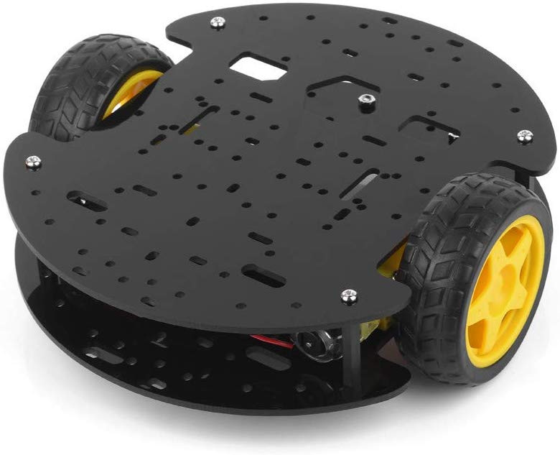
Base Objectives
Car (Controls motor steering, speed, and direction)
Path following with black electrical tape
Obstacle detection
Obstacle circumnavigation
Travel statistic logging and display

Slide 3
Stretch Goals
Advanced obstacle reaction
get accurate obstacle readings while car is in motion
detect if obstacle is moving or stationary
back up from approaching obstacle
wait out through traffic
add another motion sensor, detect moving obstacles via triangulation/sensor differences, avoidance swerving
Log exporting via serial UART cable
exporting functions triggered with a button press when plugged in
draw a map using x-y position data from a run and export the picture

Slide 4

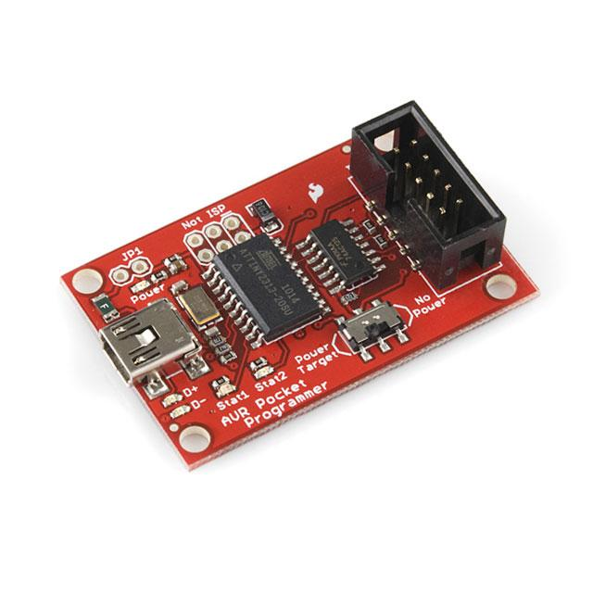
Software
Atmel Studio 7
IDE to program the ATMEGA328P-AU
Allows us to program and debug our code for the car
Will be written in C/C++
Will be using the SparkFun Electronics Pocket AVR Programmer
Using a miniUSB cable to connect the programmer and computer
10-pin programming cable that connects the programmer to a 6-pin header on our PCB
Uses an SPI interface to send data back and forth from the CPU

Slide 5
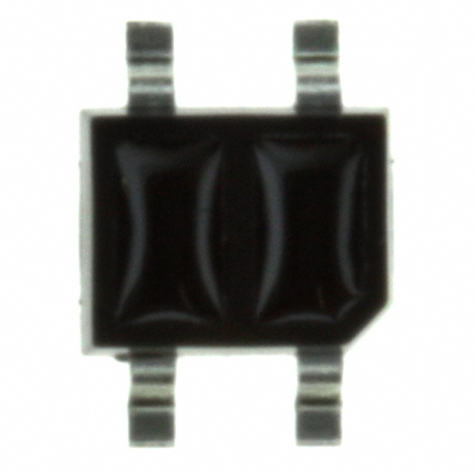
IR Sensor
3 IR sensors (Part #: QRE1113GR) will allow the car to read the black line and follow it
Sensors will be placed side by side
Facilitates tape-path follower subsystem
Two sensors will read white surface and one will read the black line
Right and left turns will be done by sensors by two of the sensors on the sides

Slide 6
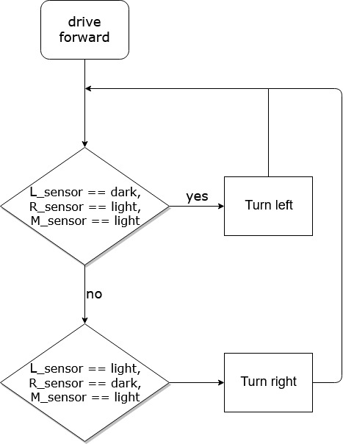
Line Tape Follower
Path following with electric tape using one single tape to make the track
Detecting right or left turn in track:
while(!endOfTravel) { if (L_sensor == dark) turnLeft(); else if (R_sensor == dark) turnRight(); else driveForward(); }

Slide 7
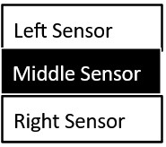
Detecting Right vs Left
Middle sensor should always detect line
Going straight, the right sensor eventually detects the line
Car knows to move right to realign middle sensor with line
Same case for the left sensor

Slide 8
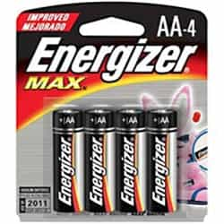
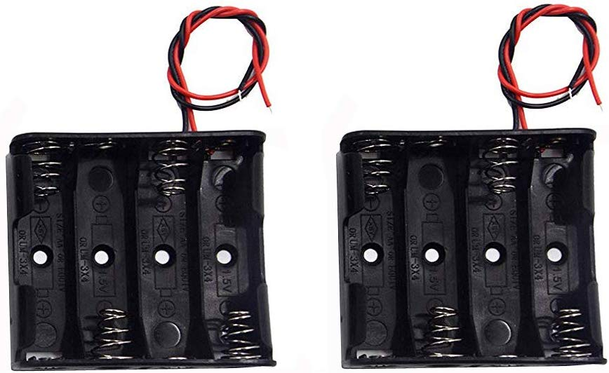
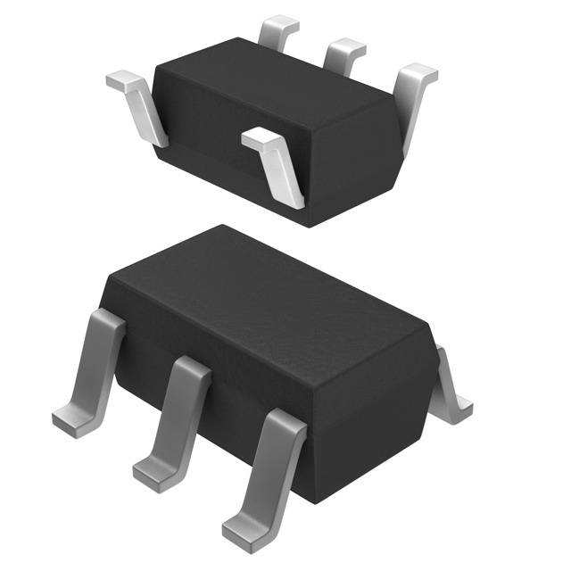
Battery
Most of our peripherals run at 5V
4 AA battery holder
Each AA battery = 1.5V
With four batteries = 6V
Paired with a voltage regulator to output 5V
AP2210K-5.0TRG1

Slide 9
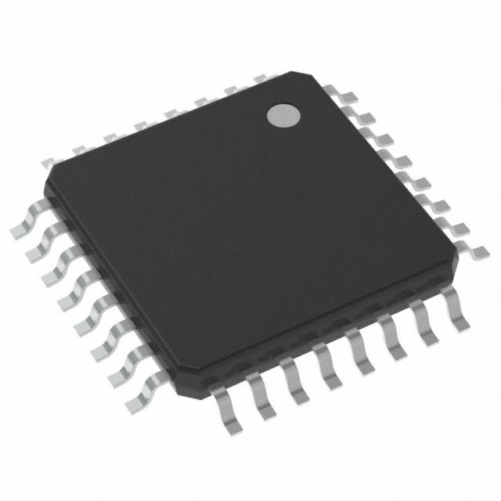
CPU: ATMEGA328P-AU
AU suffix: surface mount variant
4*8 = 32 pins
High Performance, Low Power AVR® 8-Bit Microcontroller Family
Requires voltage supply of 1.8V - 5.5V
Has 6 PWM (Pulse Width Modulation) Channels
Different ways of connectivity:
I2C, SPI(communication protocol), UART/USART(Transmit/Receive serial data)

Slide 10
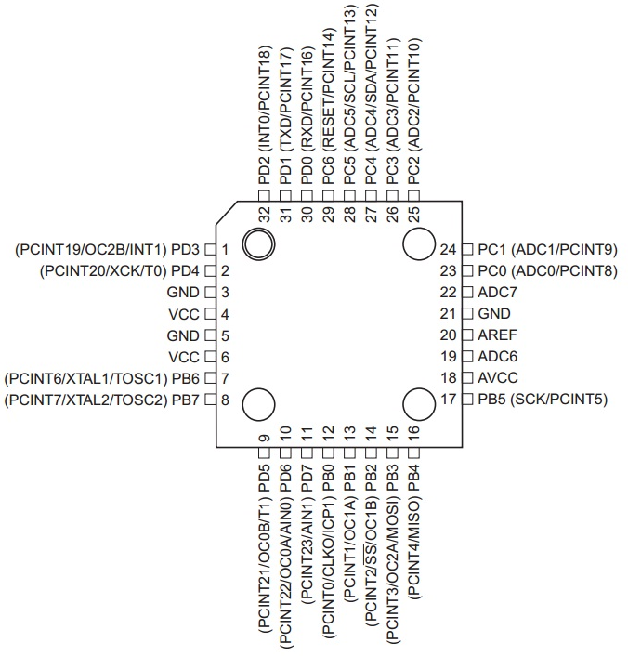
CPU Top View
VCC
Digital supply voltage
Prot B (PB7:0)
8 bit bidirectional I/O port with internal pull up resistor.
Symmetrical drive characteristics with both high sink and source capability.
Tristated when a reset condition becomes active even if the clock isn’t running
Port C (PC5:0)
7 -bit bidirectional I/O
As inputs, Port C pins that are externally pulled low will source current if the pull-up
resistors are activated.
AVCC
Supply voltage pin for the A/D Converter
AREF
Analog reference pin for the A/D Converter
ADC7:6
Serves as analog inputs to the A/D converter. The pins are powered from the analog
supply and serve as 10 bit ADC channels

Slide 11
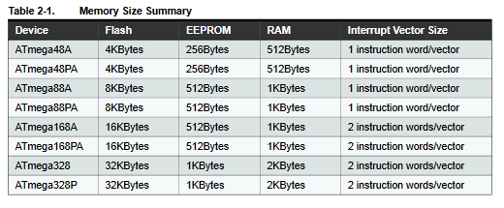
CPU: ATMEGA328P-AU
ATmega328P is different not only in memory size, its boot loader support and interrupt vector sizes is more than any other CPU listed.

Slide 12
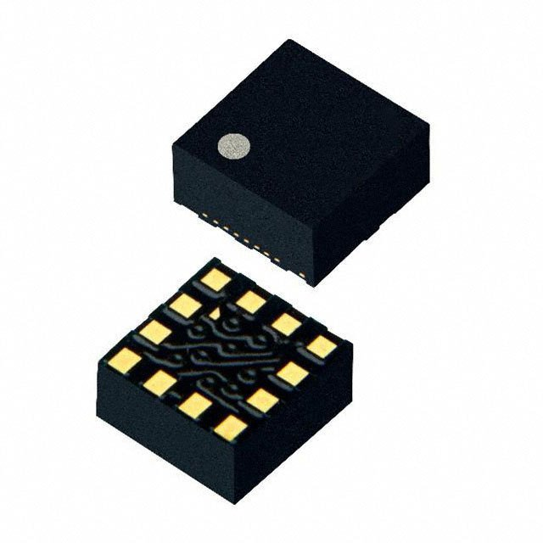
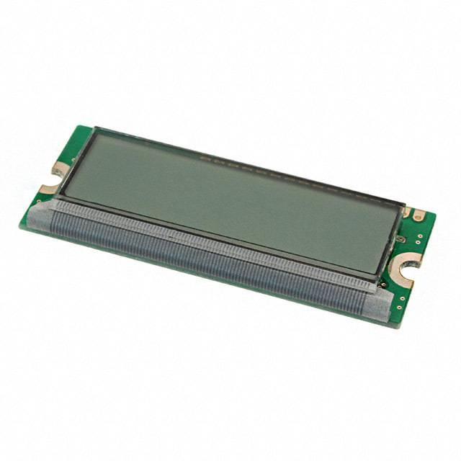
Accelerometer: KXTJ3-1057
Feeds data into CPU through I2C
Logs acceleration in X, Y, and Z-axis
Facilitates obstacle circumnavigation, travel logging, and travel statistics subsystems
Can integrate acceleration data to find velocity and position data
16x2 LCD character display on the car displays calculated averages
Accelerometer data logging will be synchronized with a crystal oscillator for accurate timekeeping and consistent, precise measurements

Slide 13
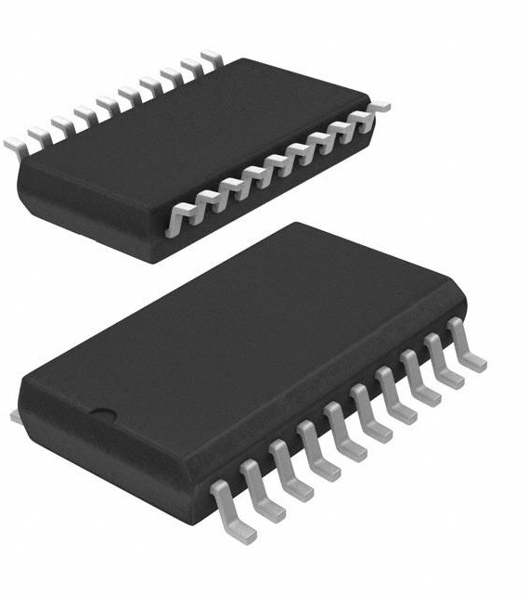
Motor Driver
L293DD H-Bridge (surface mount variant)
Facilitates steering-speed control subsystem
Switches power connections to terminals of two DC brushed motors
i.e. connect left motor terminal to V_{DD} and right motor terminal to G_{nd} for forward, vice versa
Switching motor power polarity allows steering left and right
turning can be achieved by running left and right motors in opposite directions at equal speeds, or running one motor faster than the other
Uses PWM signals to control motor speed
switch motor power on and off according to a duty cycle to get a lower average voltage supplied to motors than the constant input driving voltage

Slide 14
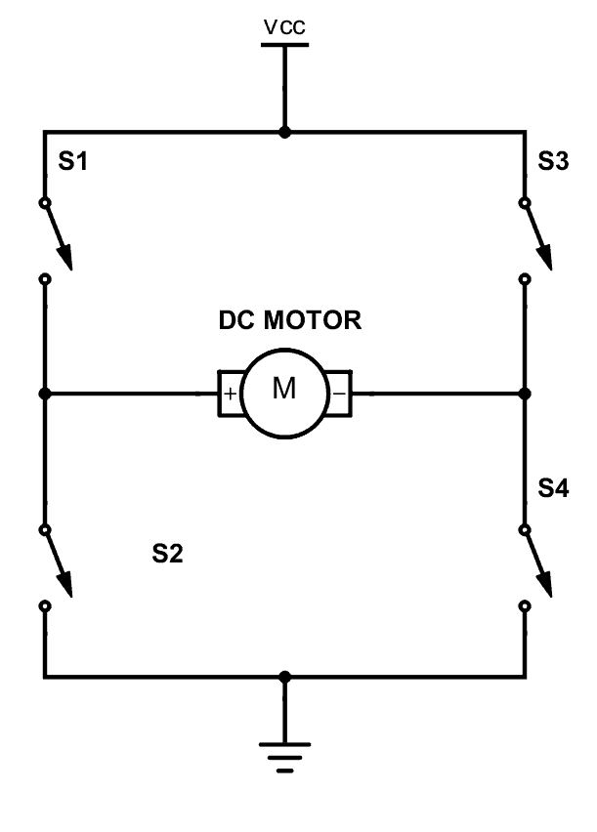
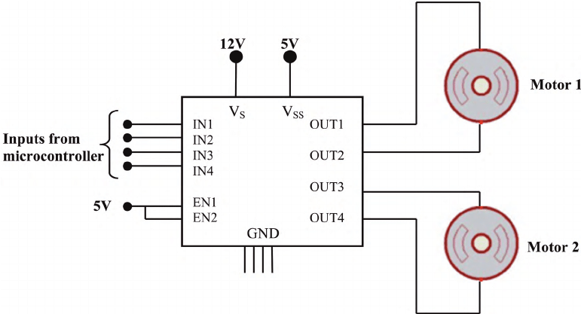
L293DD Schematic

Slide 15
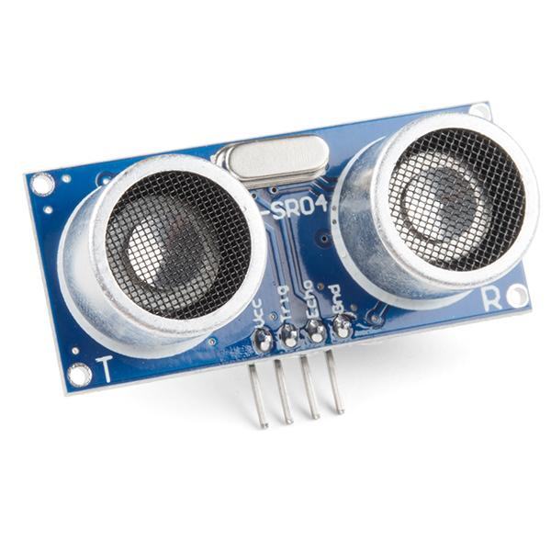
Ultrasonic Distance Sensor
SEN-15569 (HC-SR04)
Ultrasonic Sensor 40kHz
Sends out eight 40kHz signals and detects a pulse signal back
Will transmit data to CPU
Used for our car’s obstacle detection
If CPU receives signal indicating obstruction within 3 inches
Then car will activate circumnavigation system

Slide 16
Circumnavigation Algorithm
Restrictions:
Only works with objects no larger than 2x2 feet
Assuming all obstacles require no more than a 2m detour from the black path
Car will move in half circle arcs to get around an obstacle
Circumference/2 → 56cm/2 = 28cm
If car hits an object while moving, it stops and makes another half circle
Performed with a recursive function
Algorithm is interrupted once IR sensor detects the black electrical tape path
If car cannot find a path after 2m, it will flash an error message on LCD display
This will terminate the algorithm as well

Slide 17
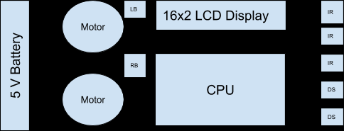

Slide 18
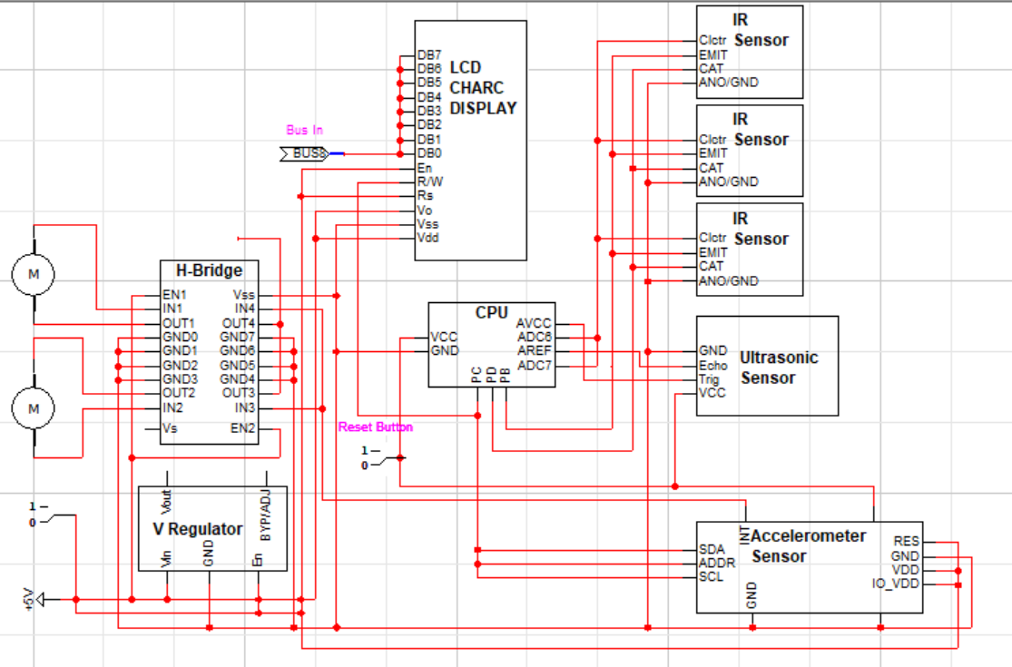
Display Data
Reading
Data
Notes:
Changes to be made:
Additional ultrasonic sensor
Arrows for each pin
Connect display bus in to CPU
Add crystal oscillator
Add pin header for log-exporting (serial UART)
Programming pin header? (3x2)
Ultrasonic sensor:
Trig & echo through GPIO
IR Sensor:
Phototransistor output

